Slide 1
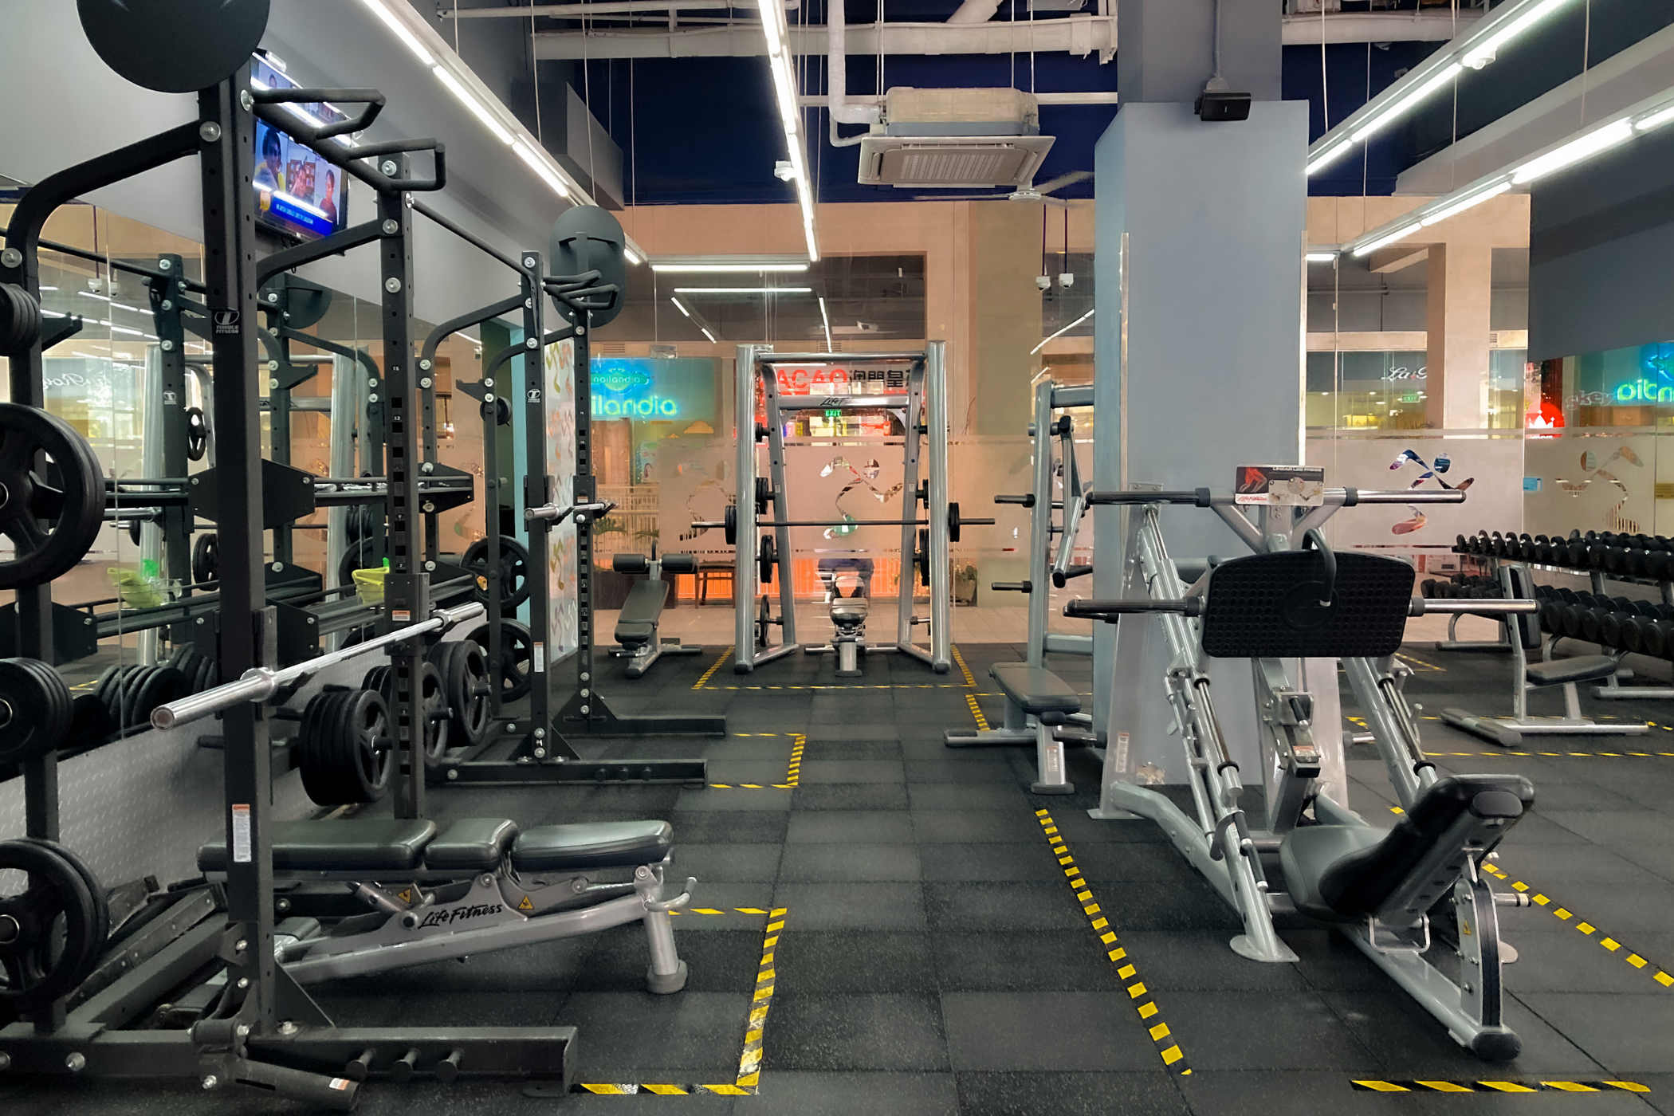
Fitness Center Management System
J.VENKATA RAHUL (RA2311026010205)
Notes:
1

Slide 2
Problem Statement
Many fitness centers today rely on inefficient, outdated systems that lead to significant losses in time and resources. Manual processes for member registration, class scheduling, and financial tracking are common, resulting in an average of 15% more administrative overhead compared to centers using integrated systems. This inefficiency translates to lost staff time, estimated at 2 hours per day per employee, and an increased risk of human error causing scheduling conflicts and billing inaccuracies.
These manual processes directly impact member satisfaction and revenue. Inaccurate record-keeping leads to scheduling conflicts, resulting in lost revenue from missed classes and frustrated members. Manual billing increases the likelihood of payment errors, late payments, and accounts receivable issues. This translates into a 10% reduction in on-time payments and a 5% increase in administrative costs for collections. Consequently, fitness centers experience reduced operational efficiency and financial instability.
Notes:
2

Slide 3
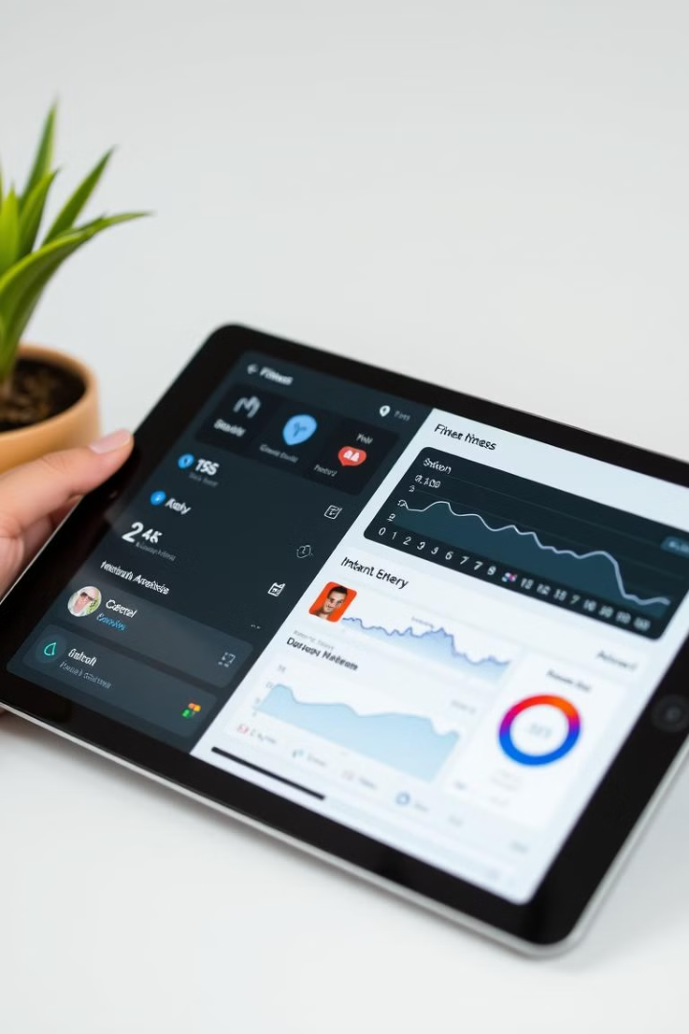
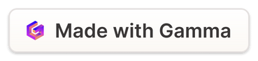
Key Features
User-Friendly Interface
Intuitive design for easy navigation and access to essential features.
Member Management
Track member information, memberships, and payments.
Scheduling and Booking
Manage class schedules, appointments, and equipment reservations.
Facility Management
Maintain equipment inventory, track usage, and schedule maintenance.
Notes:
3

Slide 4
User-Friendly Interface
Streamlined design for seamless user experience. Intuitive navigation ensures quick access to key features, minimizing time spent searching and maximizing efficiency. The interface is designed to be adaptable to different screen sizes and devices, ensuring consistent usability across platforms.
Easy-to-use interface for both staff and members. The system features clear icons, straightforward menus, and helpful tooltips, making it simple to learn and operate. Staff can quickly manage bookings, update member information, and track facility usage, while members can easily book classes, view schedules, and manage their profiles.
Notes:
4

Slide 5
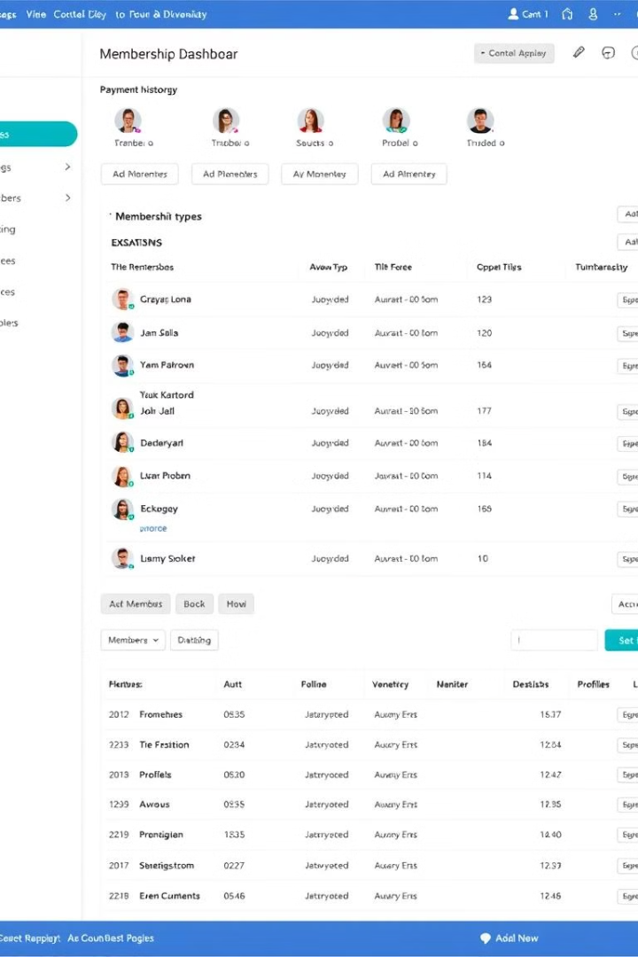



Member Management
Profile Management
Membership Tracking
Attendance Monitoring
Create and manage member profiles, including contact information and preferences.
Track membership types, renewals, and payments.
Record member attendance for classes, workouts, and appointments.
Notes:
5

Slide 6
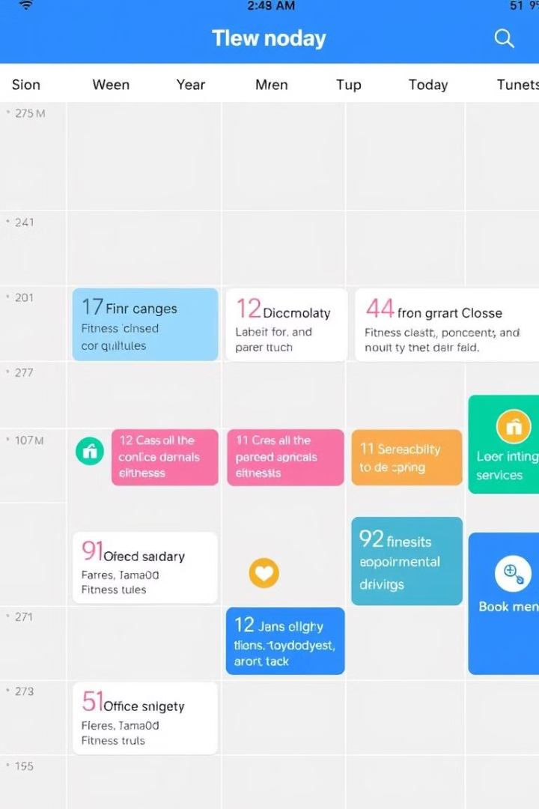
Scheduling and Booking
Manage class schedules and instructor availability.
1
Allow members to book classes, appointments, and equipment.
2
Send reminders and notifications for scheduled activities.
3
Notes:
6

Slide 7
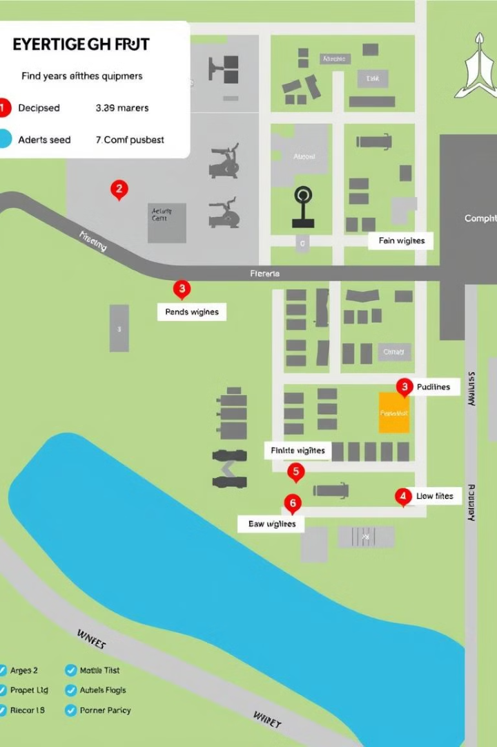
Facility Management
Equipment Inventory
Maintain a detailed inventory of all fitness equipment.
Usage Tracking
Track equipment usage and identify popular items.
Maintenance Scheduling
Schedule preventive maintenance and repairs for equipment.
Notes:
7

Slide 8
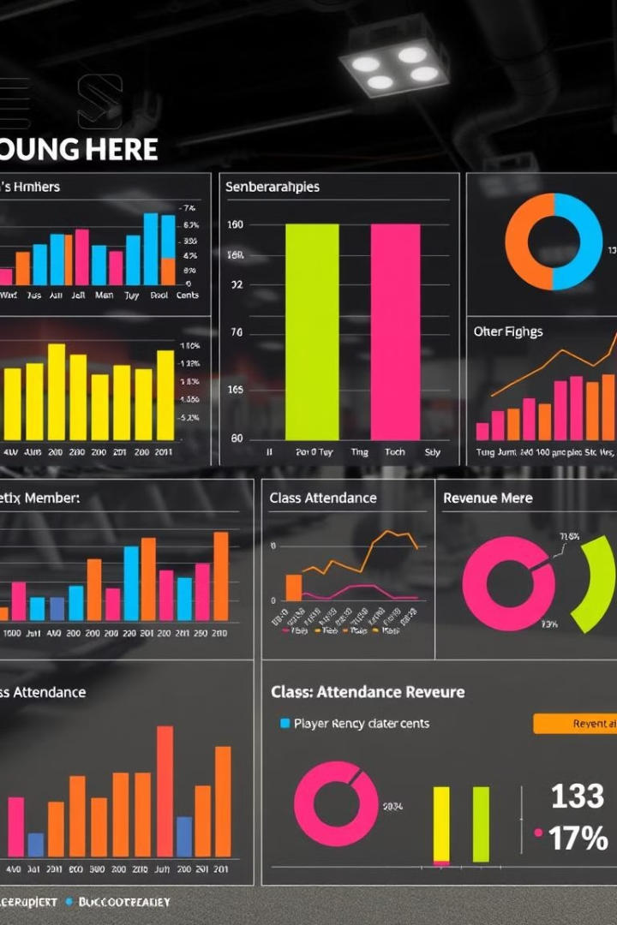
Reporting and Analytics
100
50%
Member Growth
Class Attendance
Track member acquisition and retention.
Analyze class popularity and member engagement.
Revenue
Monitor revenue streams and identify areas for improvement.
Notes:
8

Slide 9



Security and Privacy
Secure Login
1
Implement secure login credentials for staff and members.
2
Data Encryption
Protect sensitive member information with encryption protocols.
Access Control
3
Restrict access to sensitive data based on user roles and permissions.
Notes:
9

Slide 10
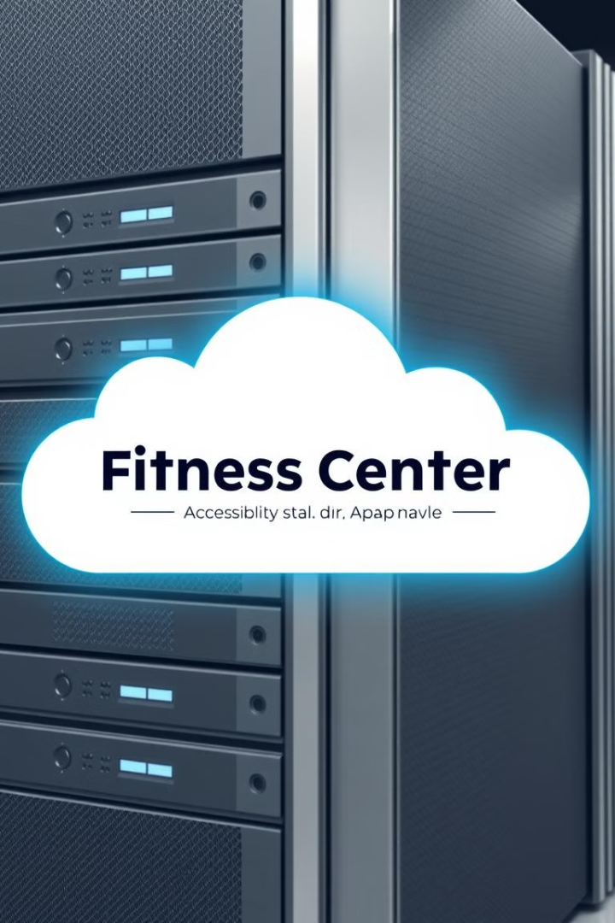



Scalability and Flexibility
Scalable architecture to accommodate growing member base.
Flexibility to customize features and workflows to meet specific needs.
Integration with existing systems for seamless data flow.
Notes:
10

Slide 11
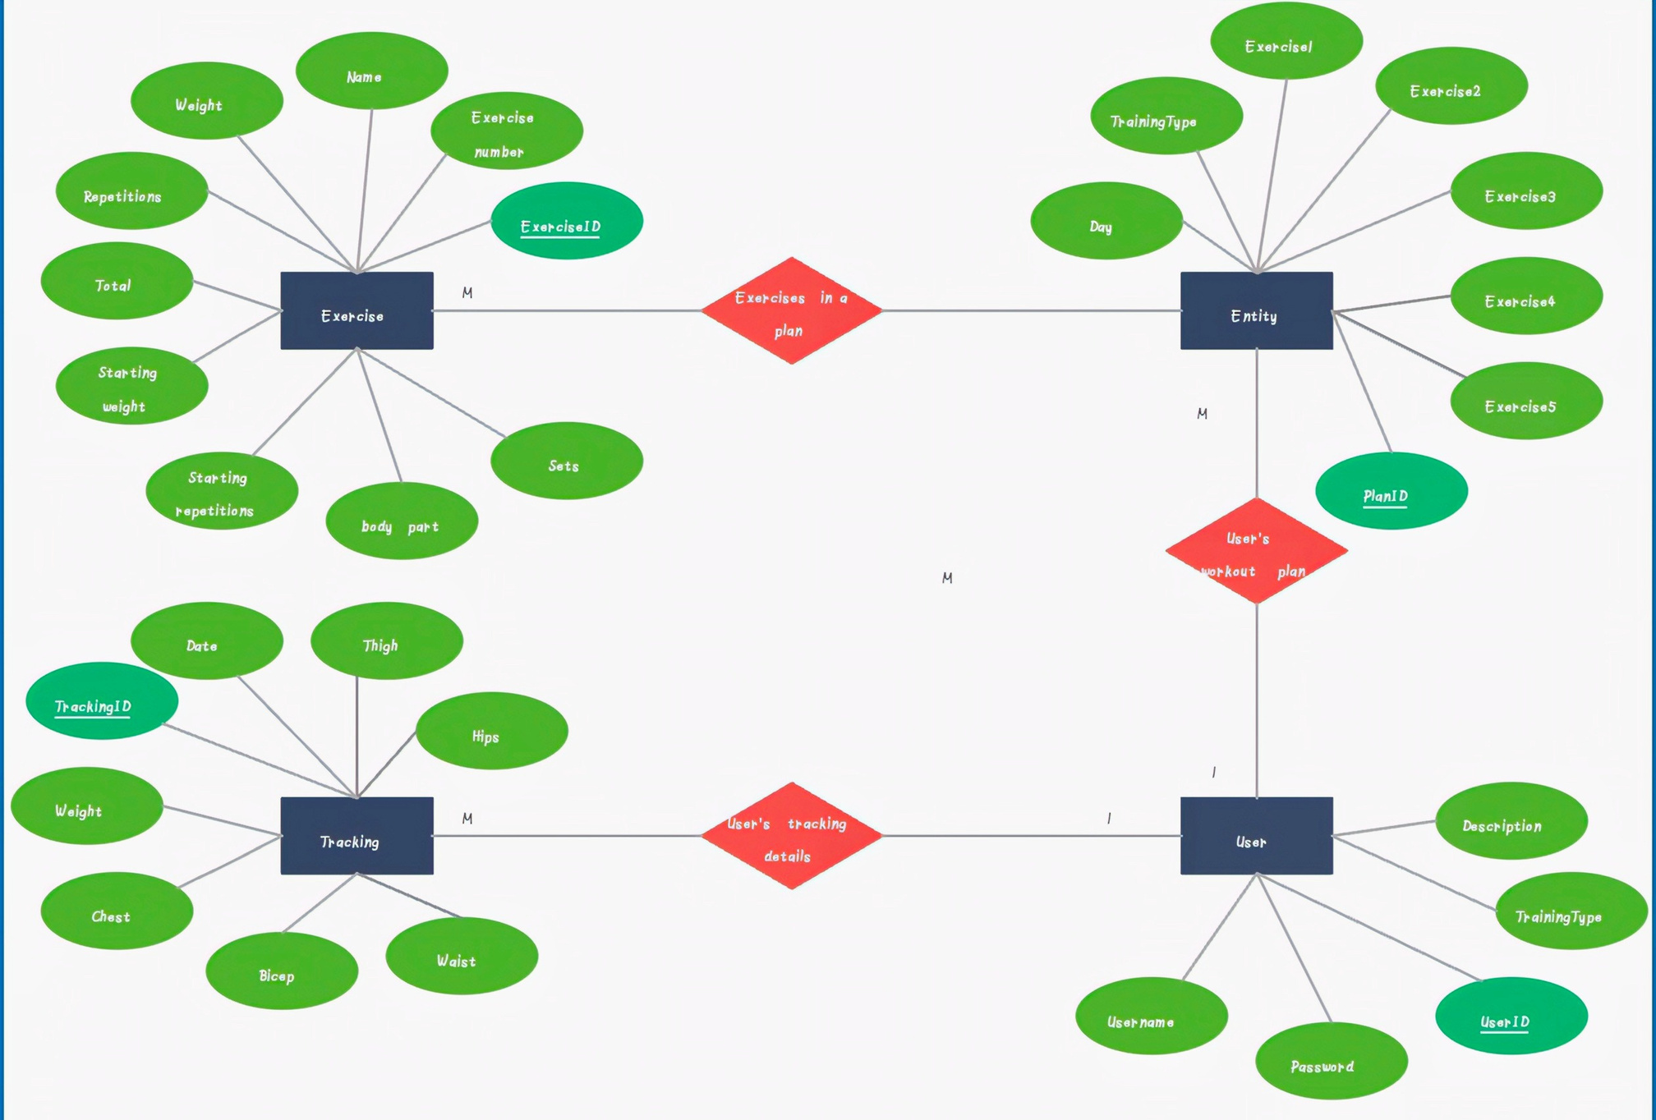
m
Workout
Plan
ER DIAGRAM

Slide 12

THANKYOU

